Slide 1
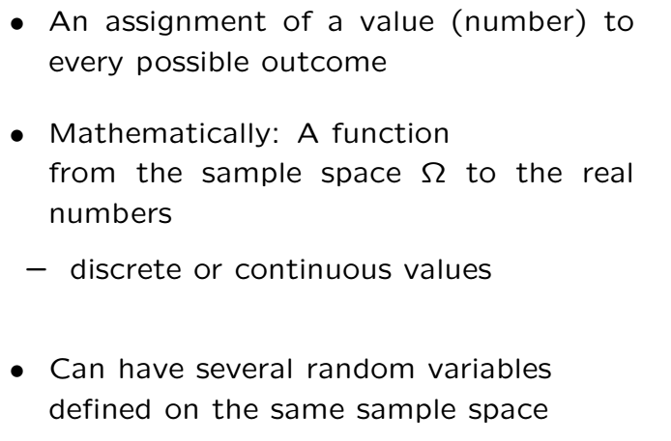
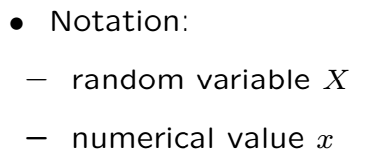
Random Variables

Slide 2

Random Variables Terminology
RVs are just tagging numerical values to experiments.
The probability assignment to outcomes can be expressed in terms of the RVs.
There are different ways to do this
• Discrete PMF
• Continuous PDF
When we talk about the “distribution” of a RV we talk about one of these ways.

Slide 3
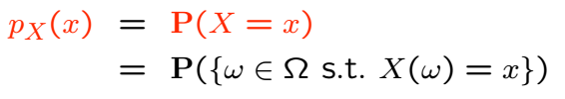
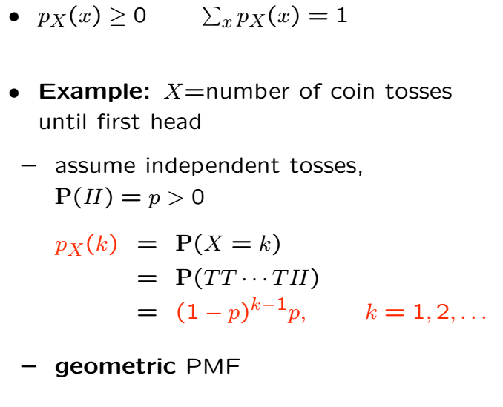
Probability Mass Function

Slide 4
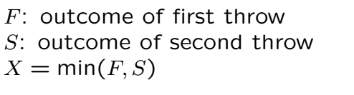
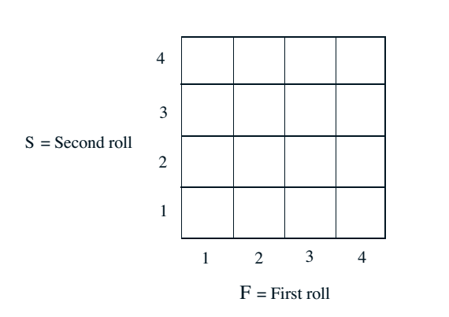

Example

Slide 5
Acknowledgements and Citations
Parts of these slides are adapted from the following resources:
Power Point Lecture Slides for the Textbook http://bcs.wiley.com/hebcs/Books?action=index&bcsId=8676&itemId=1118324560
John Tsitsiklis. 6.041 Probabilistic Systems Analysis and Applied Probability, Fall 2010. (Massachusetts Institute of Technology: MIT OpenCourseWare),http://ocw.mit.edu (Accessed 13 Apr, 2015). License: Creative Commons BY-NC-SA

